Slide 1
Journal of Experimental and Clinical Medicine (JECM) Annual Report
Kuang-Sheng Yeh, Ph.D.
Executive Editor
JECM
Taipei Medical University
Taipei, Taiwan
2011-1-6

Slide 2
JECM General Information
JECM is an official publication of Taipei Medical University.
The aim of JECM is to publish high quality scientific research in the field of experimental and clinical medicine.
JECM is published bimonthly by Elsevier.
JECM editor-in-chief: Dr. Edwin L. Cooper

Slide 3
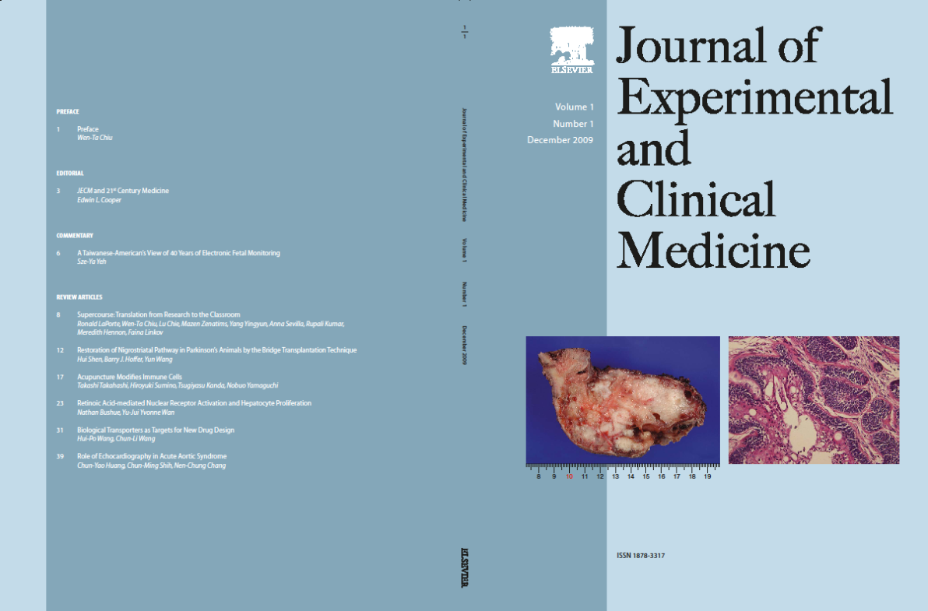
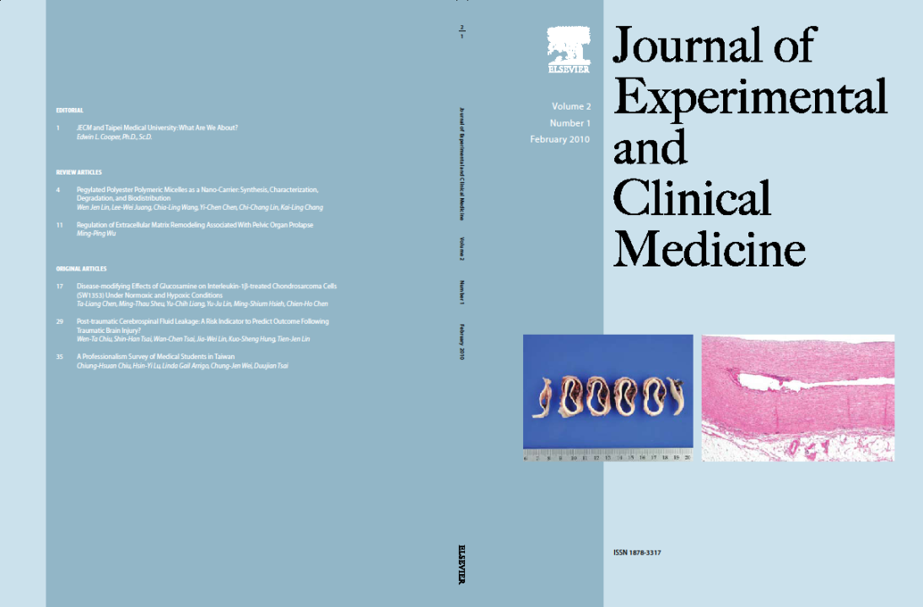

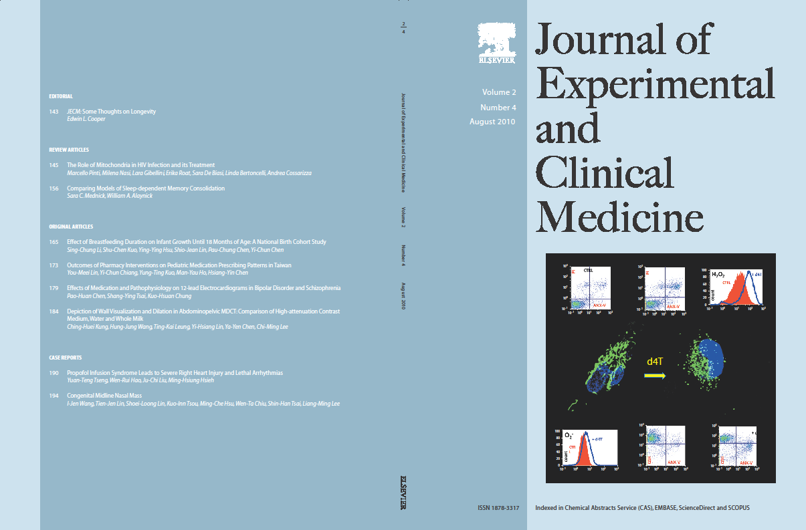
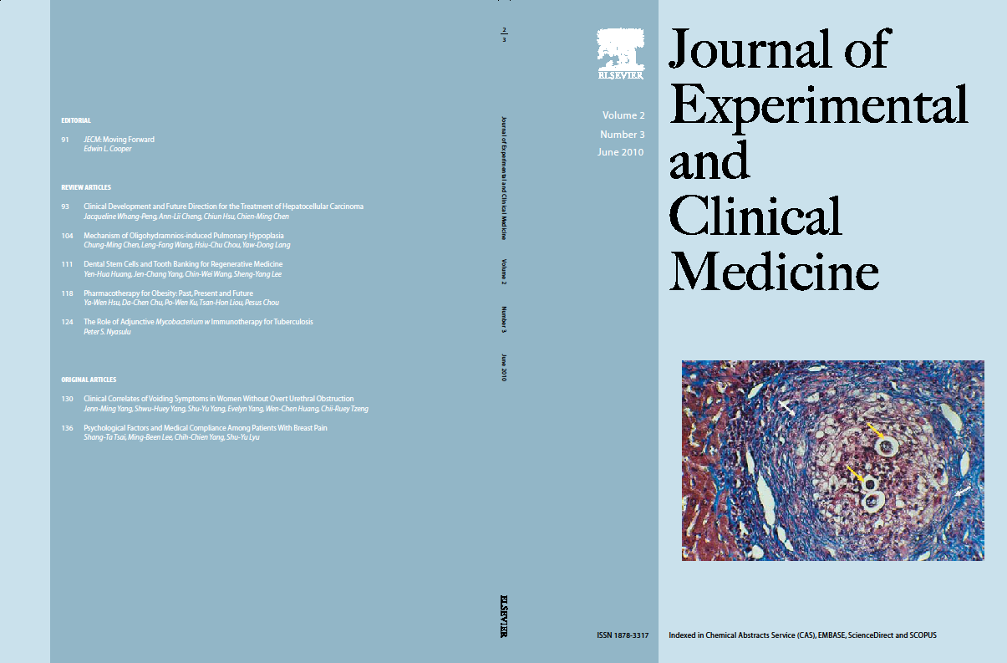
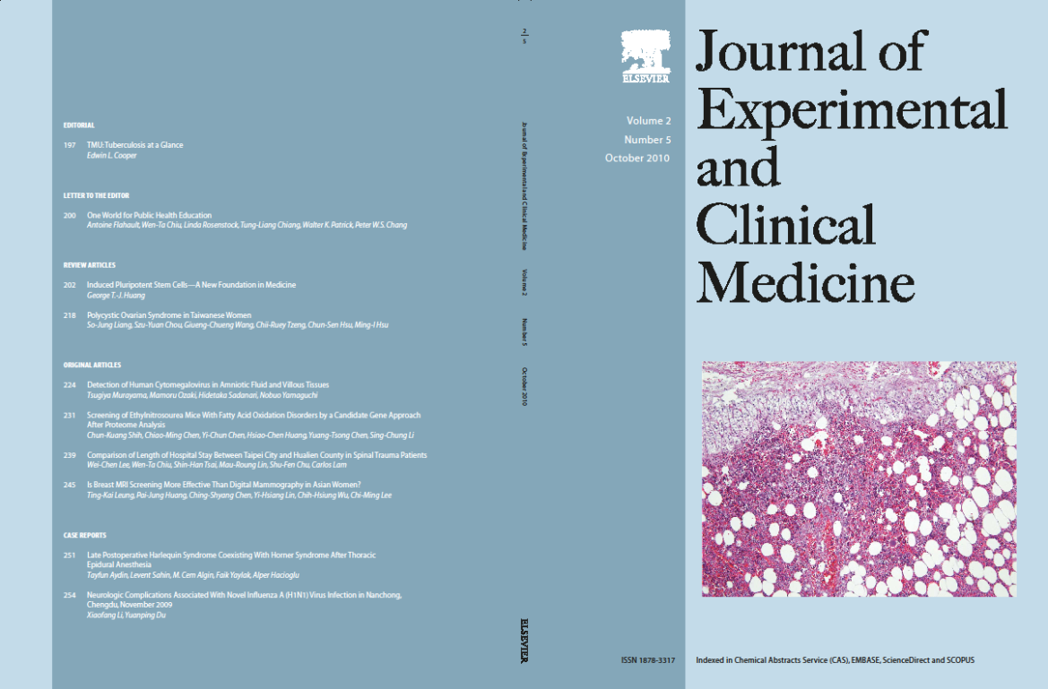
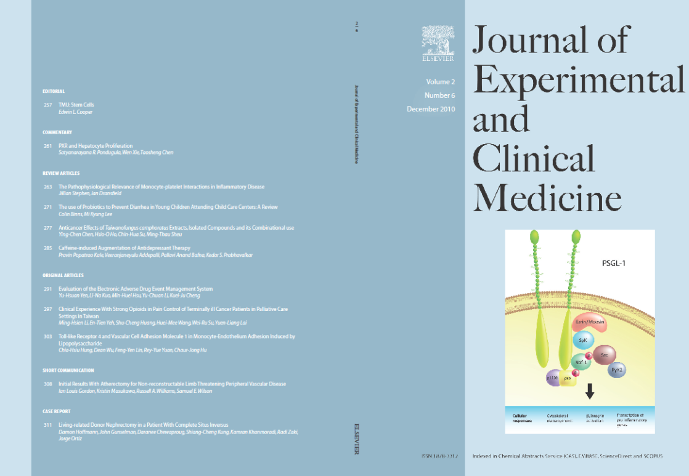

Slide 4
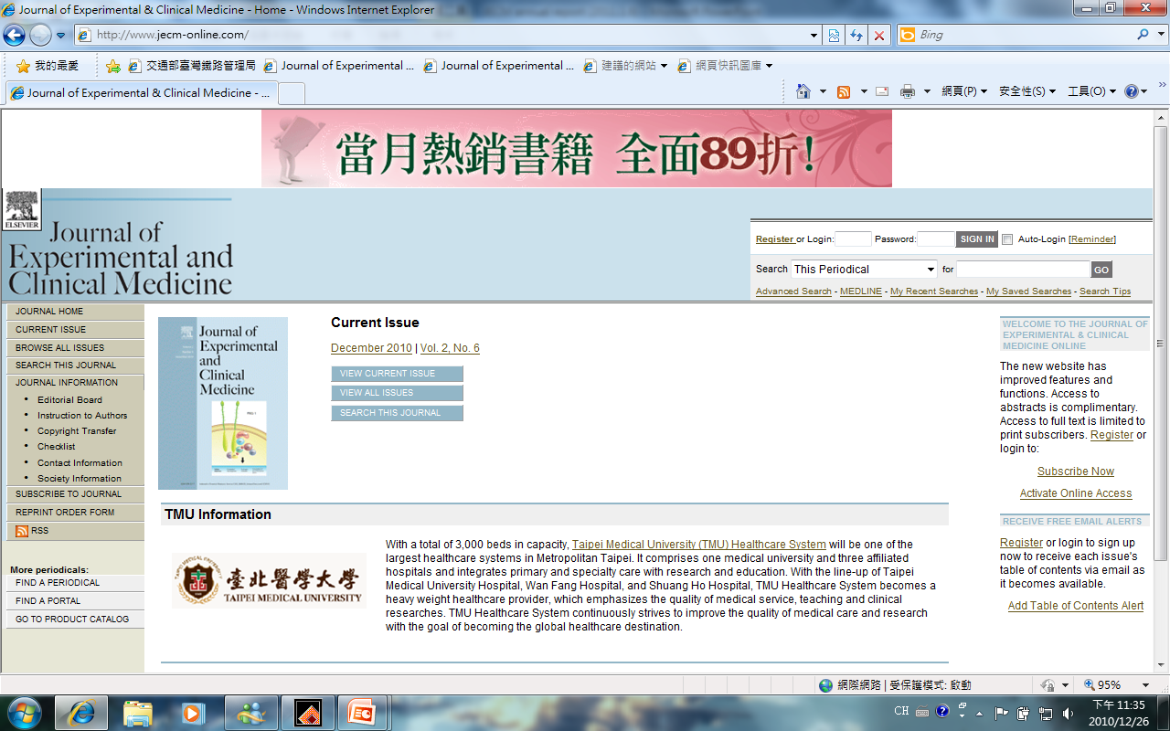
JECM website: http://www.jecm-online.com

Slide 5
SCI journal Application
Application to Thomson Scientific: Dec 3, 2009

Slide 6
JECM is indexed in the following database:
Chemical Abstracts Service (CAS)
EMBASE
ScienceDirect
Scopus

Slide 7
Medline Index Application
Application: Nov 4, 2010
Review: Feb, 2011
Result: April, 2011

Slide 8
Peer reviewed article
Total submission: 116
Accepted: 66
Reject: 15
Overdue: 14
Processing: 21
Accepted rate: 70% (66/95)

Slide 9
Manuscript submitted in 2009 (51)

Slide 10
Manuscript submitted in 2010 (65)

Slide 11
Manuscript Analysis (vol 1 No 1~vol 2 No 6)
Category of manuscript | number
Preface | 1
Letter to Editor | 1
Short Communication | 1
Commentary | 3
Case Report | 5
Editorial | 7
Original Article | 19
Review Article | 23
Total | 60

Slide 12
Percentage of the category of the manuscript

Slide 13
Countries of the Corresponding Authors (vol 1 No 1~vol 2 No 6)
Country | number
Australia | 1
India | 1
United Kingdom | 1
Turkey | 1
China | 1
Italy | 1
South Africa | 1
Japan | 2
U.S.A. | 19
Taiwan | 32
Total | 60

Slide 14
Percentage of the Countries of the Corresponding Authors

Slide 15
Institutions of the corresponding authors (Taiwan)
Institution | number
Taipei Medical University | 11
Wan Fang Hospital | 8
Taipei Medical University Hospital | 7
Shuang-Ho Hospital | 2
National Taiwan University | 1
National Health Research Institutes | 1
Chi Mei Medical Center | 1
Cathay General Hospital | 1
Total | 32

Slide 17
Institutions of the corresponding authors (Other Countries)
Institution | number
University of Pittsburgh, USA | 2
University of Edinburgh, UK | 1
Curtin University, Australia | 1
NMIMS University, India | 1
University of California, Irvine, USA | 1
Albert Einstein Medical Center, USA | 1
University of Modena and Reggio Emilia, Italy | 1
University of California, San Diego, USA | 1
Boston University, USA | 1
Hokuriku University, Japan | 1
Dumlupinar Universitesi Hastanesi, Turkey | 1
The Second Hospital of North China Medical College, China | 1
University of the Witwatersrand, South Africa | 1
Albert Einstein College of Medicine, USA | 1

Slide 18
Institutions of the corresponding authors (Other Countries)
Institution | number
TJL Associates, USA | 1
Cornell University, USA | 1
Thomas Jefferson University, USA | 1
National Institute on Drug Abuse, USA | 1
Kanazawa Medical University, Japan | 1
University of Kansas Medical Center, USA | 1
University of California at Los Angeles, USA | 7

Slide 19
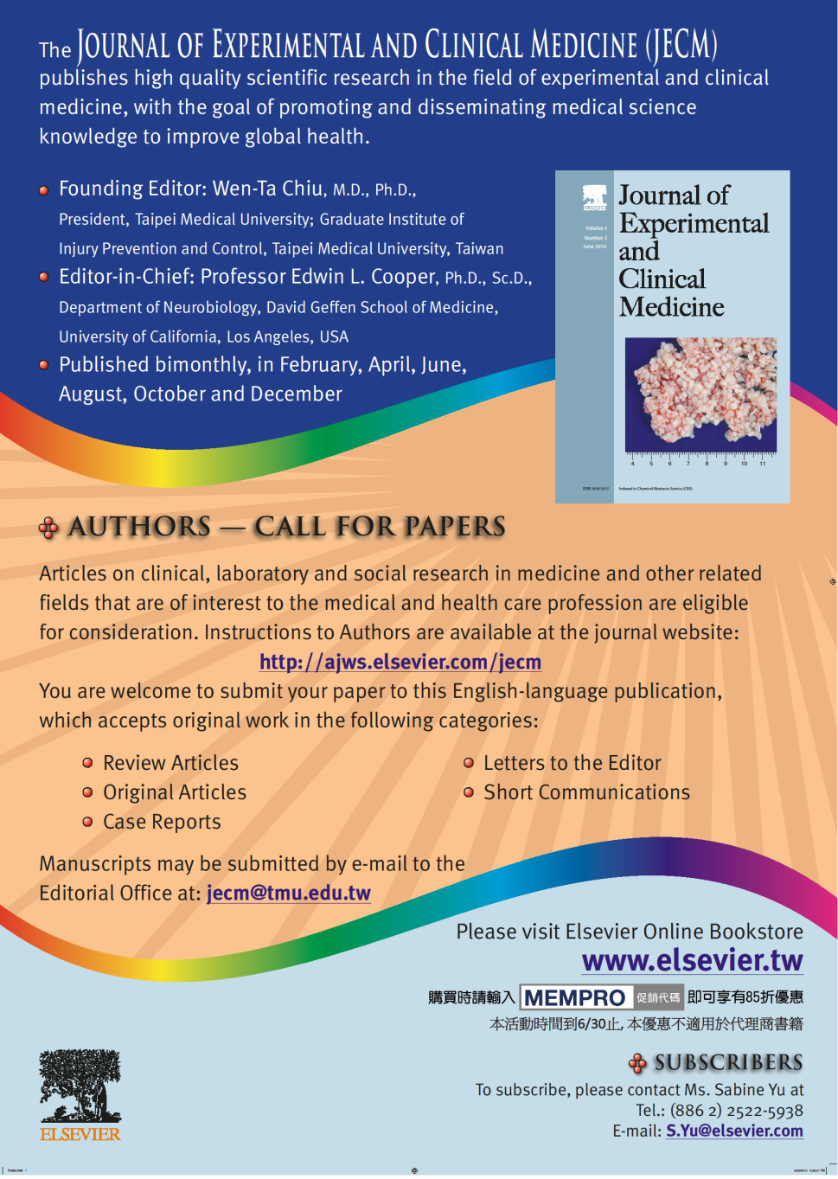
Call for paper poster

Slide 20
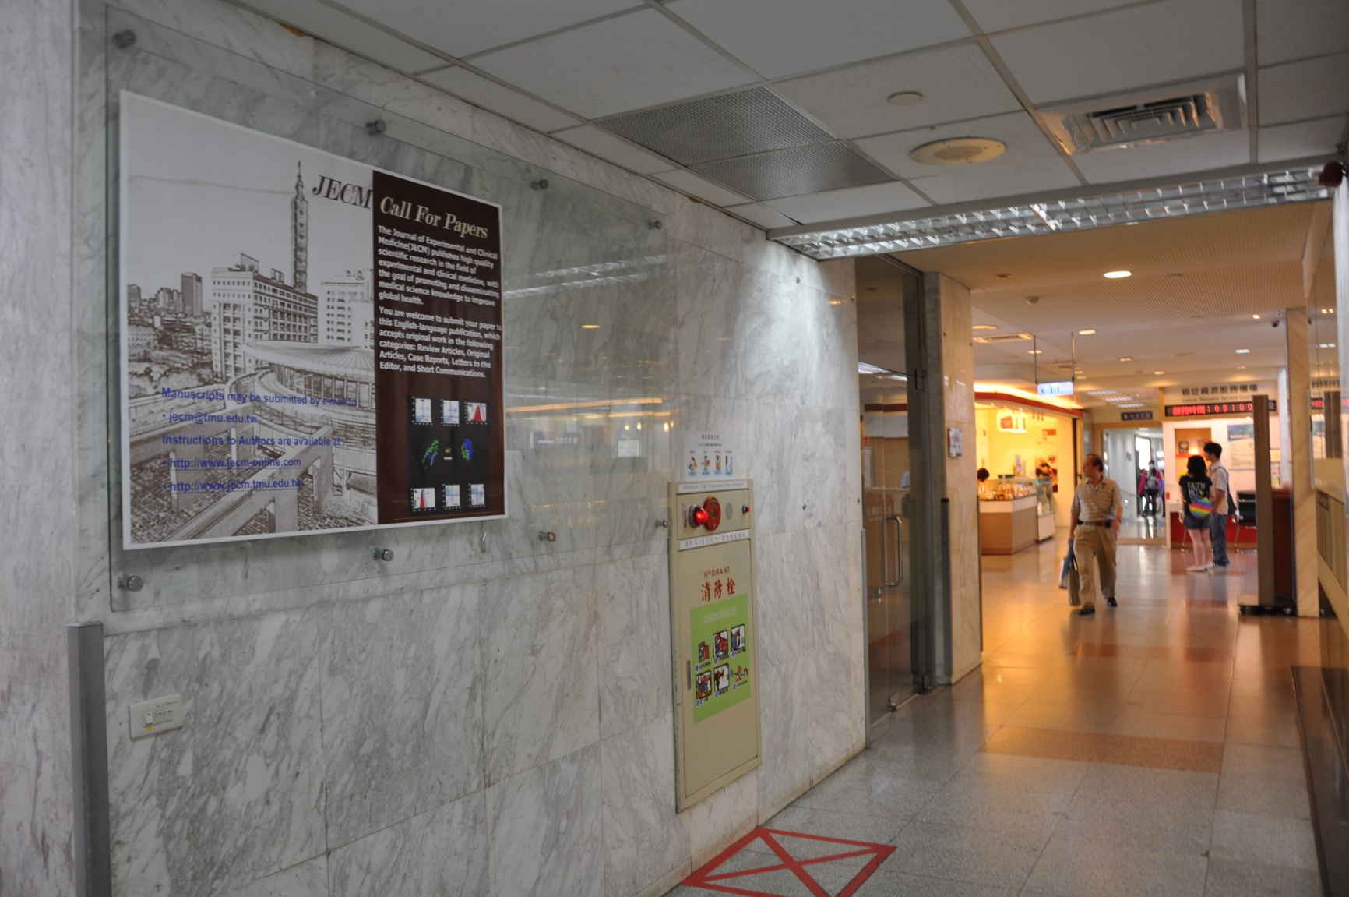
Call for paper poster (TMU hospital)

Slide 21
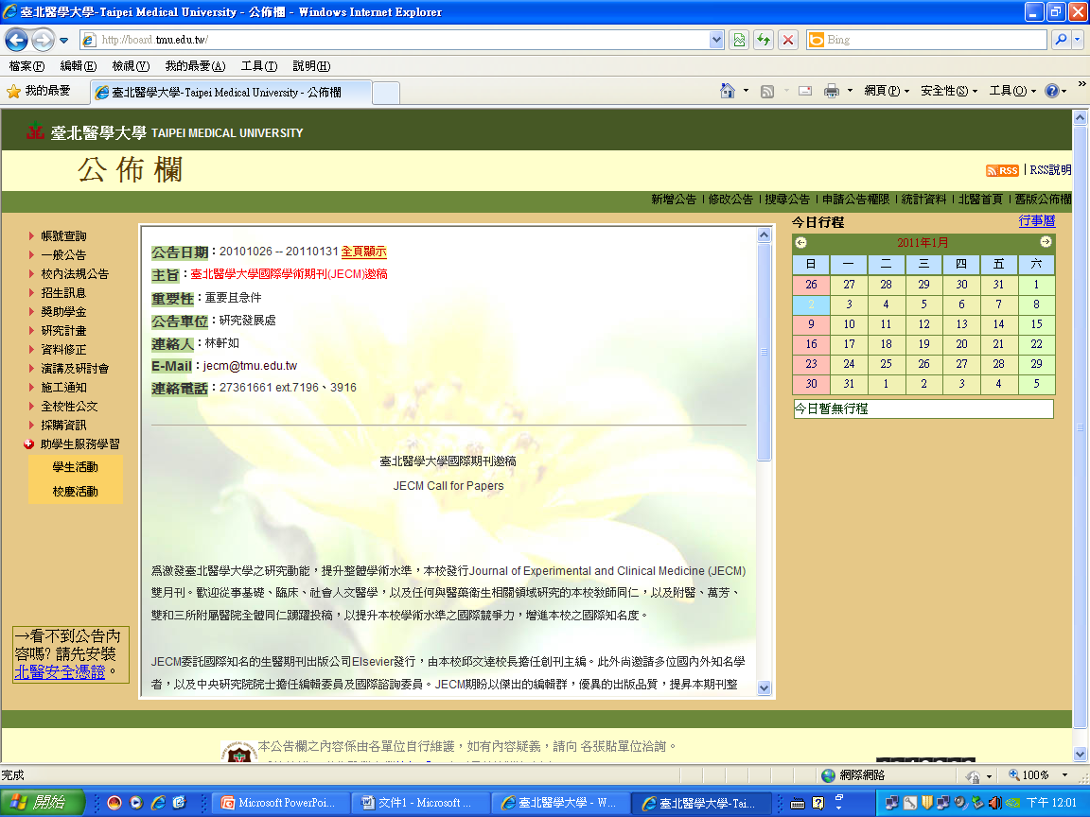
Call for paper announcement on TMU website

Slide 22
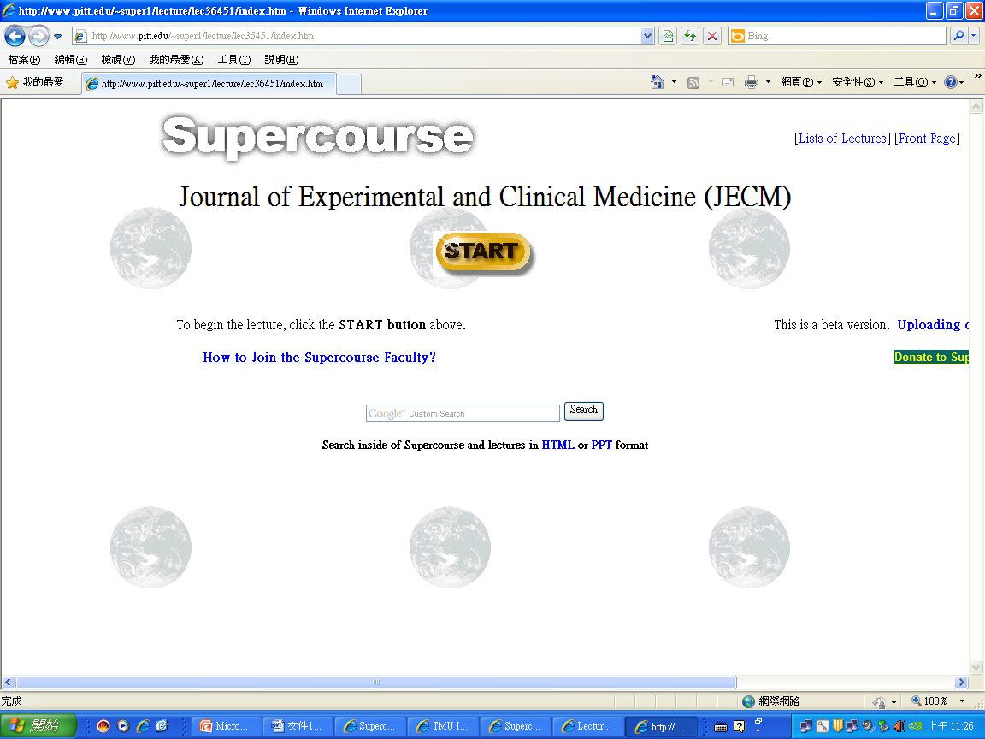
JECM in Supercourse

Slide 23
SWOT Analysis of JECM
Strengths: finically supported by TMU
Weaknesses: not listed in Medline database and SCI journals
Opportunities: international diversity
Threats: too many competitive similar journals

Slide 24
Thank you!

