Slide 1

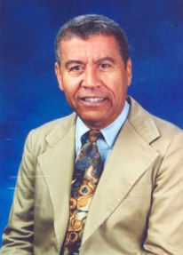
JECM專題演講
JECM Lecture
Topic：How to Write and Publish
in JECM
Speaker：Dr. Edwin L. Cooper
(TMU Chair Professor/
JECM Editor-in-Chief)
時間：100年1月6日上午10:30-11:30
Time：Jan 6, 2011 A.M. 10:30-11:30
地點：醫學綜合大樓前棟4樓誠樸廳
Location： Conference Hall, 4F, United
Medical Building (front building)
歡迎全校教職員工生參加
Everyone is welcome to attend the lecture.

